Slide 1
Saturated Absorption Spectroscopy
Anthony Plechacek and Luzando Mukubu

Slide 2
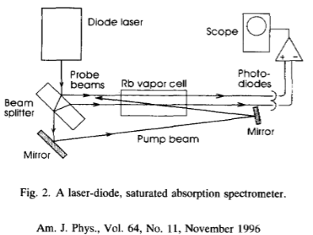
Saturated Absorption Spectroscopy

Slide 3
Experiment Update
Setup
Mount diffraction grating
Hookup photodiode
Started aligning diffraction grating

Slide 4
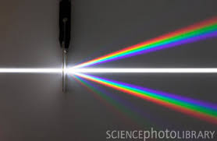
Diffraction Grating
Reflect 1st Order Diffraction into Diode
Reduces linewidth from 100MHz to 1MHz

Slide 5
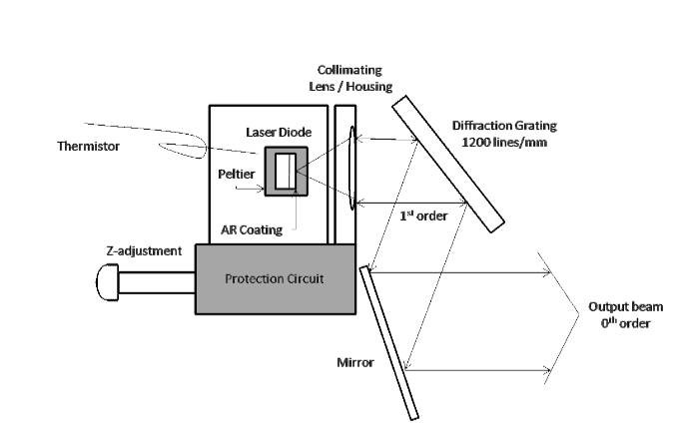


Diffraction Grating
Diffraction Equation
$2\operatorname{asin}\left(θ\right)=mλ$
a: distance between slits (ridges)
$θ$: angle of diffraction
m: diffraction order
$λ$: wavelength of incident light
$θ=28.0994°$
$a=8.33e−7$ m
$m=1$
$λ=785e−9$ m

Slide 6
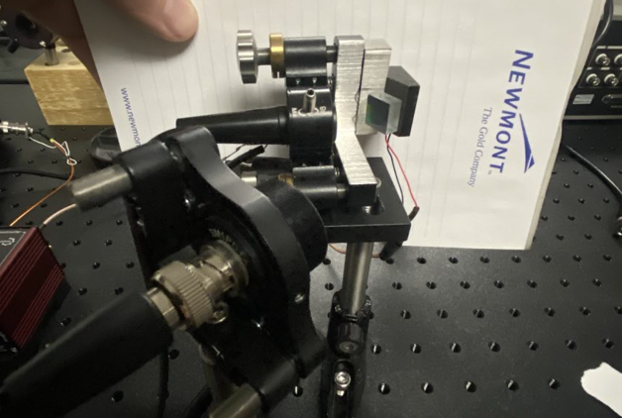

Setup

Slide 7
Current Objectives
Measure Saturated Absorption Spectroscopy of Rubidium
Tuning a diode laser
Medium Gain: through temperature
Internal Cavity: current and temperature
Grating Feedback: diffraction grating
External Cavity: piezoelectric motor
Setup Experiment
Collect Data

Slide 8

Questions

